Slide 1
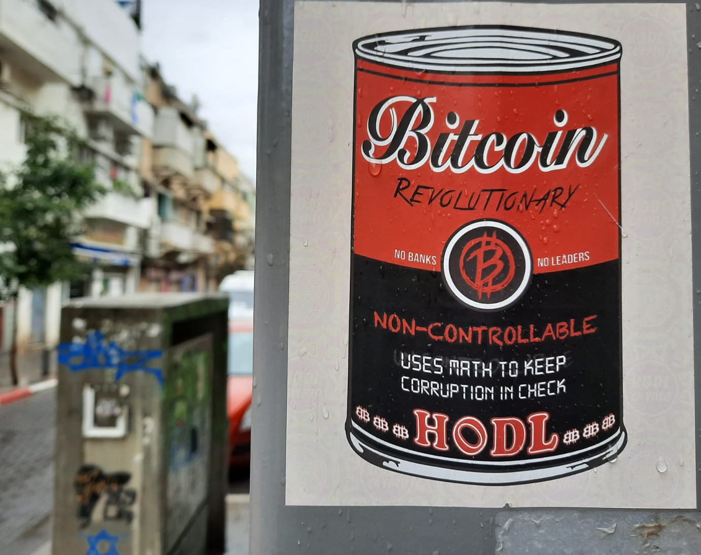
How to Reach Consensus?
Tamer elMorr
Tech2Peace NFT Weekend
September 9, 2022

Slide 2
The Three Promises of Cryptocurrency
Decentralized
No central trusted authority.
Permissionless
Anyone can join.
Cryptographically Secure
No one can break the trust in the system.
Unless they control 51% of the network, or solve a hard mathematical puzzle.

Slide 3
Consensus over a Distributed Public State
Currency
Blockchain
Decentralized, Permissionless, Secure

Slide 4
Consensus over a Distributed Public State
Decentralized, Permissionless, Secure

Slide 5
Decentralized
No central trusted authority.
Permissionless
Anyone can join.
Cryptographically Secure
No one can break the trust in the system.
Unless they control 51% of the network, or solve a hard mathematical puzzle.

Slide 6

Decentralized Currency with Friends
Ledger
Ledger
Ledger
Alice
Bob
Ledger
Ledger
Charlie
Dave
P2P Communication

Slide 7

Decentralized Currency with Friends
2$ to Bob
Ledger
Ledger
Ledger
Alice
Bob
Ledger
Ledger
Charlie
Dave
P2P Communication

Slide 8
Decentralized Currency with Friends
Ledger
Ledger
Ledger
# | from | to | amount
# | from | to | amount
# | from | to | amount
1 | Alice | Bob | 2$
Alice
1 | Alice | Bob | 2$
Bob
1 | Alice | Bob | 2$
Ledger
Ledger
# | from | to | amount
# | from | to | amount
1 | Alice | Bob | 2$
Charlie
Dave
1 | Alice | Bob | 2$
P2P Communication

Slide 9
Decentralized Currency with Friends
Ledger
Ledger
Ledger
# | from | to | amount
# | from | to | amount
# | from | to | amount
1 | Alice | Bob | 2$
Alice
1 | Alice | Bob | 2$
2 | Alice | Dave | 5$
Bob
2 | Alice | Dave | 5$
3 | Dave | Bob | 1$
3 | Dave | Bob | 1$
1 | Alice | Bob | 2$
4 | Charlie | Alice | 8$
4 | Charlie | Alice | 8$
2 | Alice | Dave | 5$
3 | Dave | Bob | 1$
Ledger
Ledger
4 | Charlie | Alice | 8$
# | from | to | amount
# | from | to | amount
1 | Alice | Bob | 2$
Charlie
Dave
1 | Alice | Bob | 2$
2 | Alice | Dave | 5$
2 | Alice | Dave | 5$
3 | Dave | Bob | 1$
3 | Dave | Bob | 1$
4 | Charlie | Alice | 8$
4 | Charlie | Alice | 8$
Tally:
Alice +1$
Bob +3$
Charlie -8$
Dave +4$
P2P Communication

Slide 10

Decentralized Currency with Strangers
Ledger
Ledger
# | from | to | amount
# | from | to | amount
1 | Alice | Bob | 2$
1 | Alice | Bob | 2$
Ledger
2 | Alice | Dave | 5$
2 | Alice | Dave | 5$
3 | Dave | Bob | 1$
3 | Dave | Bob | 1$
4 | Charlie | Alice | 8$
4 | Charlie | Alice | 8$
Ledger
# | from | to | amount
Ledger
xm835
# | from | to | amount
5_rs
1 | Alice | Bob | 2$
# | from | to | amount
2 | Alice | Dave | 5$
1 | nyc97 | xm835 | 2$
1 | Alice | Bob | 2$
3 | Dave | Bob | 1$
2 | Alice | Dave | 5$
4 | Charlie | Alice | 8$
3 | Dave | Bob | 1$
nyc97
fox00
4 | Charlie | Alice | 8$
2 | 17yyr | ojs_t | 5$
Ledger
Ledger
# | from | to | amount
3 | 17yyr | 112_r9 | 1$
# | from | to | amount
1 | Alice | Bob | 2$
1 | Alice | Bob | 2$
2 | Alice | Dave | 5$
2 | Alice | Dave | 5$
3 | Dave | Bob | 1$
3 | Dave | Bob | 1$
gov89
4 | Charlie | Alice | 8$
4 | gov89 | nyc97 | 8$
ojs_t
4 | Charlie | Alice | 8$
… | … | … | …
Ledger
Ledger
# | from | to | amount
# | from | to | amount
17yyr
112_r9
1 | Alice | Bob | 2$
1 | Alice | Bob | 2$
2 | Alice | Dave | 5$
2 | Alice | Dave | 5$
3 | Dave | Bob | 1$
3 | Dave | Bob | 1$
The Internet
4 | Charlie | Alice | 8$
4 | Charlie | Alice | 8$

Slide 11


Decentralized Currency with Strangers
2$ to 5_rs
Ledger
# | from | to | amount
1 | Alice | Bob | 2$
Ledger
2 | Alice | Dave | 5$
3 | Dave | Bob | 1$
4 | Charlie | Alice | 8$
Ledger
# | from | to | amount
Ledger
xm835
# | from | to | amount
5_rs
1 | Alice | Bob | 2$
# | from | to | amount
2 | Alice | Dave | 5$
1 | nyc97 | xm835 | 2$
1 | Alice | Bob | 2$
3 | Dave | Bob | 1$
2 | Alice | Dave | 5$
4 | Charlie | Alice | 8$
3 | Dave | Bob | 1$
nyc97
fox00
4 | Charlie | Alice | 8$
2 | 17yyr | ojs_t | 5$
Ledger
Ledger
# | from | to | amount
3 | 17yyr | 112_r9 | 1$
# | from | to | amount
1 | Alice | Bob | 2$
1 | Alice | Bob | 2$
2 | Alice | Dave | 5$
2 | Alice | Dave | 5$
3 | Dave | Bob | 1$
3 | Dave | Bob | 1$
gov89
4 | Charlie | Alice | 8$
4 | gov89 | nyc97 | 8$
ojs_t
4 | Charlie | Alice | 8$
… | … | … | …
Ledger
Ledger
# | from | to | amount
# | from | to | amount
17yyr
112_r9
1 | Alice | Bob | 2$
1 | Alice | Bob | 2$
2 | Alice | Dave | 5$
2 | Alice | Dave | 5$
3 | Dave | Bob | 1$
3 | Dave | Bob | 1$
The Internet
4 | Charlie | Alice | 8$
4 | Charlie | Alice | 8$
Assume that transactions are unforgeable (digital signatures) and publicly verifiable.
We done?

Slide 12


Decentralized Currency with Strangers
2$ to ojs_t
2$ to 5_rs
Ledger
# | from | to | amount
1 | Alice | Bob | 2$
Ledger
2 | Alice | Dave | 5$
3 | Dave | Bob | 1$
4 | Charlie | Alice | 8$
Ledger
# | from | to | amount
Ledger
xm835
# | from | to | amount
5_rs
1 | Alice | Bob | 2$
# | from | to | amount
2 | Alice | Dave | 5$
1 | nyc97 | xm835 | 2$
1 | Alice | Bob | 2$
3 | Dave | Bob | 1$
2 | Alice | Dave | 5$
4 | Charlie | Alice | 8$
3 | Dave | Bob | 1$
nyc97
fox00
4 | Charlie | Alice | 8$
2 | 17yyr | ojs_t | 5$
Ledger
Ledger
# | from | to | amount
3 | 17yyr | 112_r9 | 1$
# | from | to | amount
1 | Alice | Bob | 2$
1 | Alice | Bob | 2$
2 | Alice | Dave | 5$
2 | Alice | Dave | 5$
3 | Dave | Bob | 1$
3 | Dave | Bob | 1$
gov89
4 | Charlie | Alice | 8$
4 | gov89 | nyc97 | 8$
ojs_t
4 | Charlie | Alice | 8$
… | … | … | …
Ledger
Ledger
# | from | to | amount
# | from | to | amount
17yyr
112_r9
1 | Alice | Bob | 2$
1 | Alice | Bob | 2$
2 | Alice | Dave | 5$
2 | Alice | Dave | 5$
3 | Dave | Bob | 1$
3 | Dave | Bob | 1$
The Internet
4 | Charlie | Alice | 8$
4 | Charlie | Alice | 8$
Assume that transactions are unforgeable (digital signatures) and publicly verifiable.
Currency is a consensus problem.

Slide 13
Decentralized
No central trusted authority.
Permissionless
Anyone can join.
Cryptographically Secure
No one can break the trust in the system.
Unless they control 51% of the network, or solve a hard mathematical puzzle.

Slide 14


Digital Currency with a Trusted Dictator
ojs_t
Ledger
nyc97
# | from | to | amount
1 | nyc97 | xm835 | 2$
112_r9
2 | 17yyr | ojs_t | 5$
3 | 17yyr | 112_r9 | 1$
chstxy
4 | gov89 | nyc97 | 8$
… | … | … | …
5_rs
It is easy to achieve consensus through a trusted center that decides everything.
fox00

Slide 15
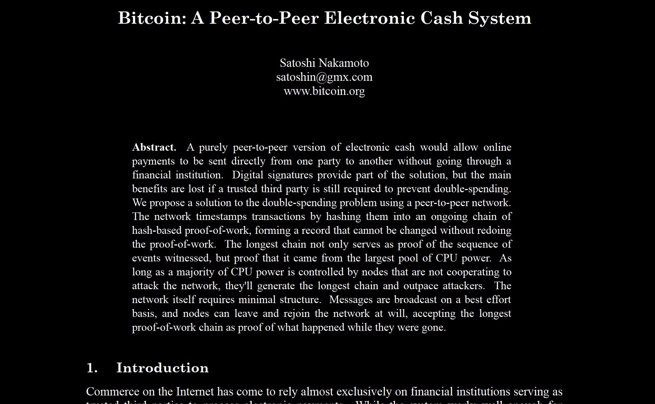
The Blockchain Solution

Slide 16
The Blockchain Solution
Main Idea:
- Update the state in rounds (aka blocks), few updates at a time.
Block #1
Initial State
Block #2
Block #3
from | content
from | content
xm835 | update
lero_7 | update
17yyr | update
jfkr87 | update
- At every round, a new random leader is chosen to create the new block.
- Every participant has his own copy of the ledger (aka the blockchain) and accepts a new block if all transactions are valid.

Slide 17
Decentralized Currency with Strangers
2$ to ojs_t
2$ to 5_rs
Ledger
# | from | to | amount
1 | Alice | Bob | 2$
Ledger
2 | Alice | Dave | 5$
3 | Dave | Bob | 1$
4 | Charlie | Alice | 8$
Ledger
# | from | to | amount
Ledger
xm835
# | from | to | amount
5_rs
1 | Alice | Bob | 2$
# | from | to | amount
2 | Alice | Dave | 5$
1 | nyc97 | xm835 | 2$
1 | Alice | Bob | 2$
3 | Dave | Bob | 1$
2 | Alice | Dave | 5$
4 | Charlie | Alice | 8$
3 | Dave | Bob | 1$
nyc97
fox00
4 | Charlie | Alice | 8$
2 | 17yyr | ojs_t | 5$
Ledger
Ledger
# | from | to | amount
3 | 17yyr | 112_r9 | 1$
# | from | to | amount
1 | Alice | Bob | 2$
1 | Alice | Bob | 2$
2 | Alice | Dave | 5$
2 | Alice | Dave | 5$
3 | Dave | Bob | 1$
3 | Dave | Bob | 1$
gov89
4 | Charlie | Alice | 8$
4 | gov89 | nyc97 | 8$
ojs_t
4 | Charlie | Alice | 8$
… | … | … | …
Ledger
Ledger
# | from | to | amount
# | from | to | amount
17yyr
112_r9
1 | Alice | Bob | 2$
1 | Alice | Bob | 2$
2 | Alice | Dave | 5$
2 | Alice | Dave | 5$
3 | Dave | Bob | 1$
3 | Dave | Bob | 1$
The Internet
4 | Charlie | Alice | 8$
4 | Charlie | Alice | 8$
Assume that transactions are unforgeable (digital signatures) and publicly verifiable.
Currency is a consensus problem.

Slide 18

Life Cycle on Blockchain
satoshi
nyc97
xm835
5_rs
fox00
gov89
112_r9
17yyr
ojs_t
chstxy

Slide 19
Life Cycle on Blockchain
0. Genesis Block is created and published.
Initial State
Block #1
satoshi
nyc97
xm835
5_rs
fox00
gov89
112_r9
17yyr
ojs_t
chstxy

Slide 20

Life Cycle on Blockchain
Pending Updates
from | content
1. Anyone can propose updates to the shared state.
xm835 | update
gov89 | update
17yyr | update
Initial State
Block #1
satoshi
nyc97
xm835
5_rs
fox00
gov89
112_r9
17yyr
ojs_t
chstxy

Slide 21
Life Cycle on Blockchain
Pending Updates
from | content
2. Every once in a while, a random leader is chosen to create the next block.
xm835 | update
gov89 | update
17yyr | update
Initial State
Block #1
satoshi
nyc97
xm835
5_rs
fox00
gov89
112_r9
17yyr
ojs_t
chstxy

Slide 22

Life Cycle on Blockchain
Pending Updates
from | content
3. Leader verifies all pending updates.
xm835 | update
gov89 | update
17yyr | update
Initial State
Block #1
Valid Updates
from | content
xm835 | update
17yyr | update
satoshi
nyc97
xm835
5_rs
fox00
gov89
112_r9
17yyr
ojs_t
chstxy

Slide 23
Life Cycle on Blockchain
Pending Updates
from | content
4. Leader publishes new block with new updates.
Block #1
Initial State
Block #2
from | content
xm835 | update
17yyr | update
satoshi
nyc97
xm835
5_rs
fox00
gov89
112_r9
17yyr
ojs_t
chstxy

Slide 24
Life Cycle on Blockchain
Pending Updates
from | content
5. Repeat.
nyc97 | update
chstxy | update
17yyr | update
Block #1
Initial State
Block #2
from | content
xm835 | update
17yyr | update
satoshi
nyc97
xm835
5_rs
fox00
gov89
112_r9
17yyr
ojs_t
chstxy

Slide 25
Life Cycle on Blockchain
0. Genesis Block is created and published.
1. Anyone can propose updates.
2. Every once in a while, network chooses a leader at random.
3. Leader verifies all pending updates.
4. Leader publishes new block with new updates.
5. Repeat.

Slide 26

Decentralized
No central trusted authority.
Permissionless
Anyone can join.
Cryptographically Secure
No one can break the trust in the system.
Unless they control 51% of the network, or solve a hard mathematical puzzle.

Slide 27
Life Cycle on Blockchain
0. Genesis Block is created and published.
1. Anyone can propose updates.
2. Every once in a while, network chooses a leader.
3. Leader verifies all pending updates.
4. Leader publishes new block with new updates.
5. Repeat.
How to choose a leader?

Slide 28
Original Consensus Problem
Agree on a Ledger
A Simpler Consensus Problem
Agree on a Leader for the next block

Slide 29
Electing a Leader
A fixed leader?
Not decentralized.
A lottery (at random, equal chances)?
Not secure because permissionless.
A “cryptographic lottery”.
Proof of Work (PoW)
The more you work the higher your chances to win.
Proof of Stake (PoS)
The richer you are the higher your chances to win.

Slide 30

Proof of Work
Every block contains a hard mathematical puzzle.
Block #283
Block #284
from | content
from | content
xm835 | update
fox00 | update
satoshi | update
17yyr | update
satoshi
nyc97
xm835
5_rs
fox00
gov89
112_r9
17yyr
ojs_t
chstxy

Slide 31

Proof of Work
The next block has to contain the solution.
Block #283
Block #284
from | content
from | content
xm835 | update
fox00 | update
satoshi | update
17yyr | update
satoshi
nyc97
xm835
5_rs
fox00
gov89
112_r9
17yyr
ojs_t
chstxy

Slide 32
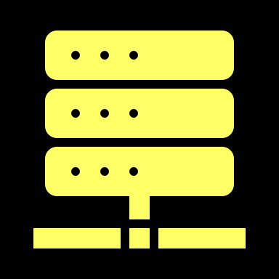
Proof of Work
Whoever is interested tries to find a solution to the puzzle, aka mining.
Block #283
Block #284
from | content
from | content
xm835 | update
fox00 | update
satoshi | update
17yyr | update
satoshi
nyc97
xm835
5_rs
fox00
gov89
112_r9
17yyr
ojs_t
chstxy

Slide 33

Proof of Work
Whoever finds the solution to the puzzle publishes the block and becomes the leader.
Block #283
Block #284
Block #285
from | content
from | content
from | content
xm835 | update
fox00 | update
nyc97 | update
satoshi | update
17yyr | update
satoshi
nyc97
xm835
5_rs
fox00
gov89
112_r9
17yyr
ojs_t
chstxy

Slide 34
Proof of Work
Cryptography: there are no “smart ways around”.
The more you work the higher your chances to win.
30%
30%
20%
10%
10%
satoshi
nyc97
xm835
5_rs
fox00
gov89
112_r9
17yyr
ojs_t
chstxy

Slide 35
Life Cycle on Blockchain with PoW
0. Genesis Block is created and published.
1. Anyone can propose updates.
2. Miners try to solve the puzzle in the last block.
3. When a miner finds a solution (in Ethereum <1 minute),
they create a block with the new updates and publish it.
4. The new block, with a new puzzle, is added to the blockchain.
5. Repeat.

Slide 36

What if Leader is Malicious?
Block #283
Block #284
from | content
from | content
xm835 | update
fox00 | update
satoshi | update
17yyr | update
satoshi
nyc97
xm835
5_rs
fox00
gov89
112_r9
17yyr
ojs_t
chstxy

Slide 37




What if Leader is Malicious?
Block #285
Block #283
Block #284
from | content
from | content
xm835 | update
fox00 | update
satoshi | update
17yyr | update
Block #285
satoshi
nyc97
xm835
5_rs
fox00
gov89
112_r9
17yyr
ojs_t
chstxy

Slide 38

What if Leader is Malicious?
Block #285
Block #285
Block #283
Block #284
from | content
from | content
xm835 | update
fox00 | update
satoshi | update
17yyr | update
Block #285
Tie breaker:
Accept the longest chain.
satoshi
nyc97
xm835
5_rs
fox00
gov89
112_r9
17yyr
ojs_t
chstxy

Slide 39


What if Leader is Malicious?
Block #285
Block #285
Block #283
Block #284
from | content
from | content
xm835 | update
fox00 | update
satoshi | update
17yyr | update
Block #285
Tie breaker:
Accept the longest chain.
satoshi
nyc97
xm835
5_rs
fox00
gov89
112_r9
17yyr
ojs_t
chstxy

Slide 40
Distributed Power is Essential
Decentralization and security are guaranteed only if the computational power in network is distributed.
30%
30%
20%
10%
10%
satoshi
nyc97
xm835
5_rs
fox00
gov89
112_r9
17yyr
ojs_t
chstxy

Slide 41

The 51% Attack
If someone has 51% of the network’s power, they can disturb consensus.
51%
51%
30%
9%
10%
satoshi
nyc97
xm835
5_rs
fox00
gov89
112_r9
17yyr
ojs_t
chstxy

Slide 42
Life Cycle on Blockchain with PoW
0. Genesis Block is created and published.
1. Anyone can propose updates.
2. Miners try to solve the puzzle in the last block.
3. When a miner finds a solution (in Bitcoin, takes ~6 minutes),
they create a block with the new updates and publish it.
4. The new block, with a new puzzle, is added to the blockchain.
5. Repeat.

Slide 43
Mining - Incentive
Mining is essential for a PoW network.
Why would you mine?
Block rewards
The creation of each block produces new coin, which goes to the creator of the block.
This is how new coin is produced in Bitcoin.
Reward halves every 210,00 blocks.
No reward by 2140.
Update fees
Fees are attached to new updates and paid by their publishers.

Slide 44
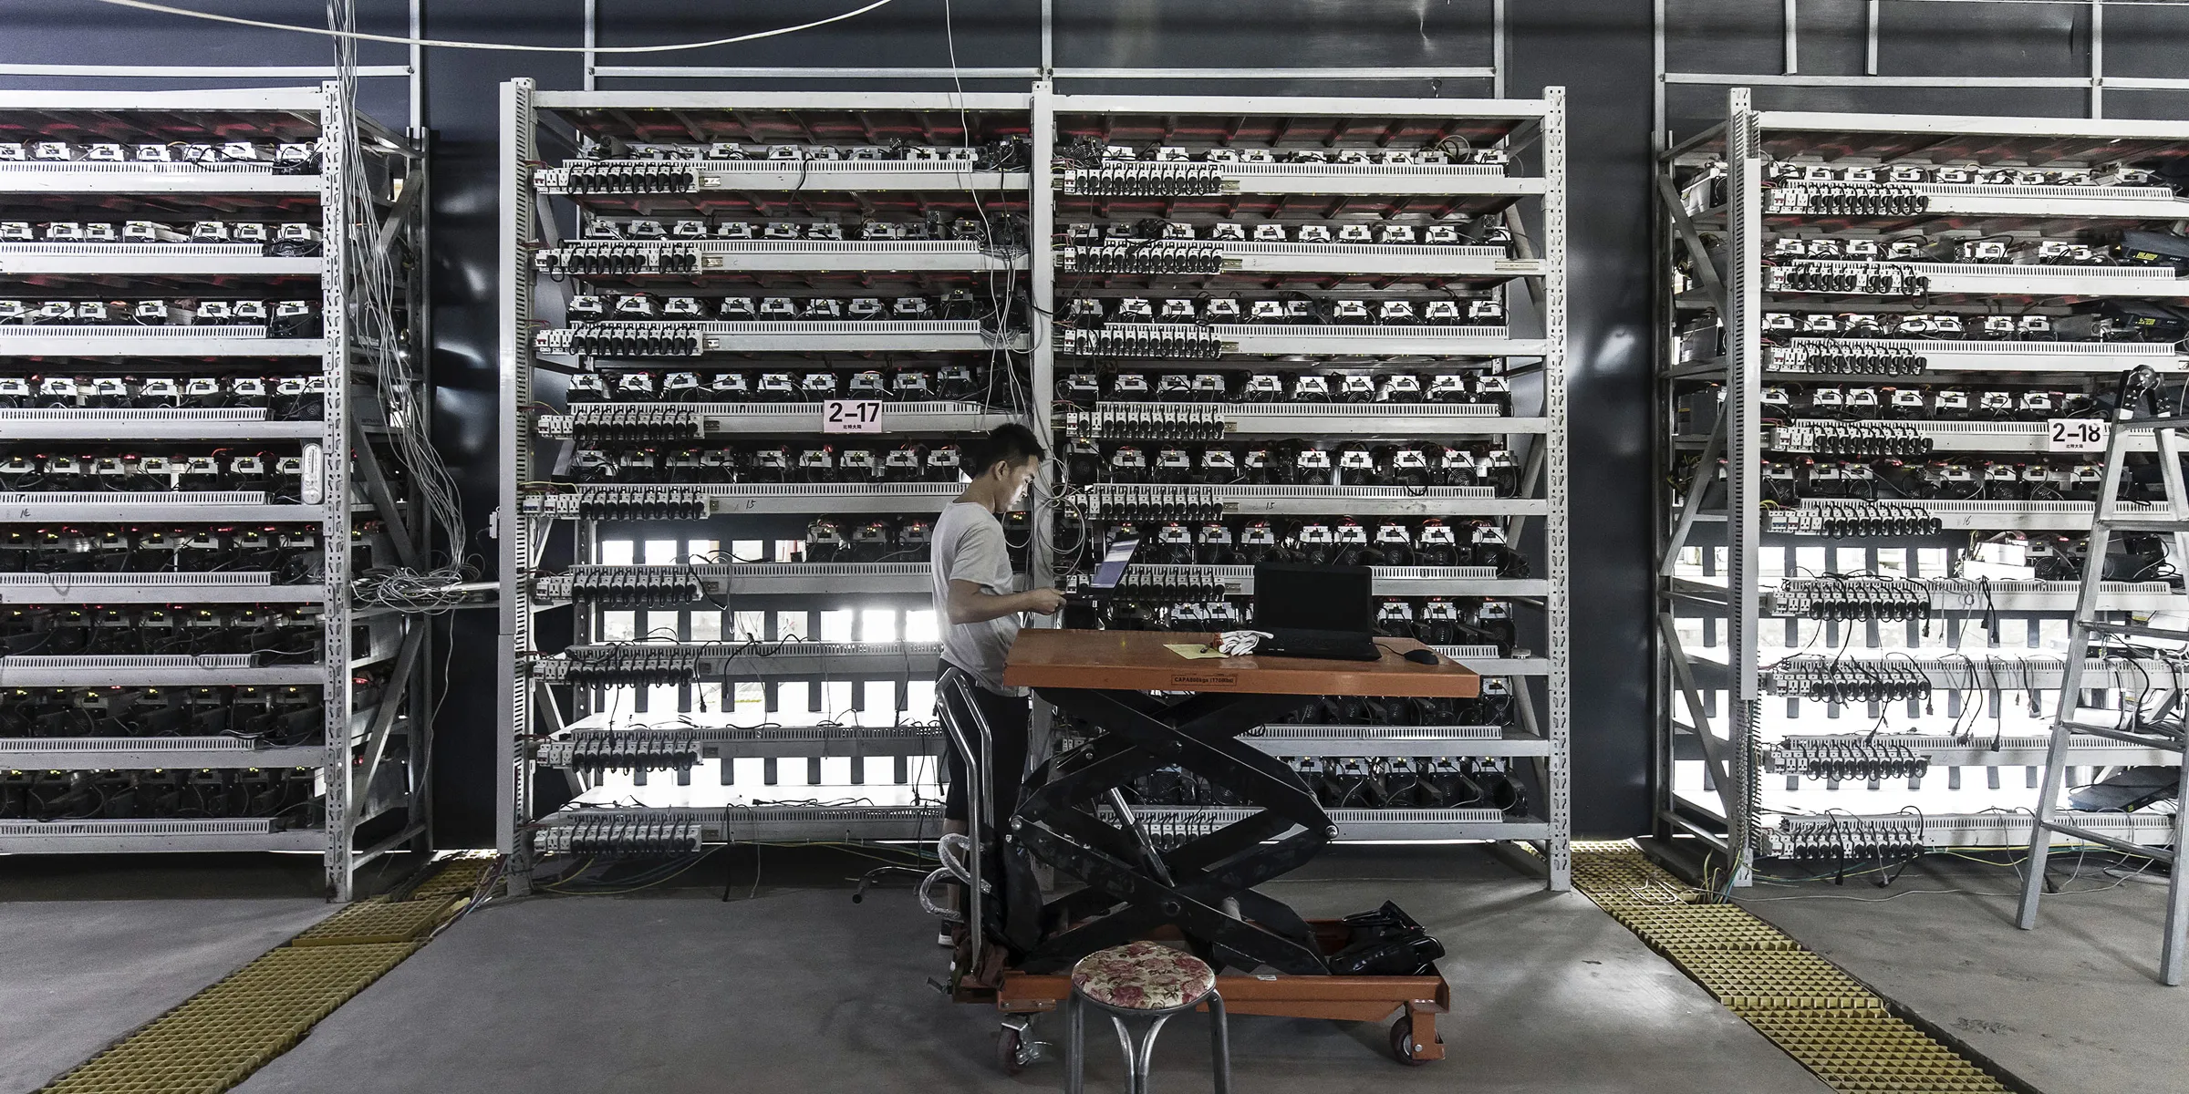

Slide 45
Recap
Cryptocurrencies require a consensus protocol which is
Permissionless
Decentralized
Cryptographically Secure
Blockchain is such a protocol.
Blockchain reduces the consensus problem to the problem of agreeing on a leader.
Proof of Work (PoW) uses cryptography to choose an owner in a permissionless, decentralized and secure way.

Slide 46
Consensus over a Distributed Public State
Currency
Blockchain
Decentralized, Permissionless, Secure

Slide 47
Ethereum’s Smart Contracts

Slide 48

Consensus over a Distributed Public State
Anything
(that can be done by a computer)
Blockchain
Decentralized, Permissionless, Secure
Smart Contracts
Implement any application in a Decentralized, Permissionless and Secure way.

Slide 49

Elections via a Traditional Web App
Sever Code (the “Contract”)
Server-Client Infrastructure
Elections {
List candidates;
List voters;
Array vote_count;
Candidate winner;
Vote(candidate) {
vote_count[candidate]++;
update_winner();
}
update_winner() {
winner = max(vote_count);
}
}
server
Vote(32)
Vote(17)
Vote(5)
clients

Slide 50
Elections via a Decentralized App (DAPP)
The “Contract”
P2P Infrasturcture
Elections {
public List candidates;
public List voters;
public Array vote_count;
public Candidate winner;
public Vote(candidate) {
vote_count[candidate]++;
update_winner();
}
private update_winner() {
winner = max(vote_count);
}
}
Ledger
Ledger
# | from | to | amount
# | from | to | amount
1 | Alice | Bob | 2$
1 | Alice | Bob | 2$
2 | Alice | Dave | 5$
2 | Alice | Dave | 5$
3 | Dave | Bob | 1$
3 | Dave | Bob | 1$
4 | Charlie | Alice | 8$
4 | Charlie | Alice | 8$
Public State
Anyone can update state according to rules.
Ledger
Ledger
# | from | to | amount
# | from | to | amount
1 | Alice | Bob | 2$
1 | Alice | Bob | 2$
2 | Alice | Dave | 5$
2 | Alice | Dave | 5$
3 | Dave | Bob | 1$
3 | Dave | Bob | 1$
4 | Charlie | Alice | 8$
4 | Charlie | Alice | 8$

Slide 51
Life of a Smart Contract
satoshi
nyc97
xm835
5_rs
fox00
gov89
112_r9
17yyr
ojs_t
chstxy

Slide 52
Life of a Smart Contract
1. A smart contract is deployed: its code is written on the blockchain.
Block #792
Contract #403
Elections {
public vote_count;
public Vote(candidate) {
...
}
}
vote_count={}
new Election()
satoshi
nyc97
xm835
5_rs
fox00
gov89
112_r9
17yyr
ojs_t
chstxy

Slide 53
Life of a Smart Contract
2. Any user can interact with the contract by calling its functions (a txn).
Block #792
Contract #403
Elections {
public vote_count;
public Vote(candidate) {
...
}
}
vote_count={}
#403.Vote(17)
satoshi
nyc97
xm835
5_rs
fox00
gov89
112_r9
17yyr
ojs_t
chstxy

Slide 54
Life of a Smart Contract
3. The creator of the next block executes the function call and updates the state of the contract.
Block #792
Block #792
Contract #403
Contract #403
Elections {
public vote_count;
public Vote(candidate) {
...
}
}
112_r9: #403.Vote(17)
vote_count[17]=1
vote_count={}
#403.Vote(17)
satoshi
nyc97
xm835
5_rs
fox00
gov89
112_r9
17yyr
ojs_t
chstxy

Slide 55
The Ethereum Blockchain
Model:
The public state contains smart contracts.
Each contract has its own public state and its own set of rules.
2. Anyone can update the state as follows:
Deploy a new smart contract (that implements a DAPP).
Update the state of any smart contract by a function call.
The consensus protocol allows to reach consensus over the state.
Function calls cost Ether, which is paid to the block creator.

Slide 56
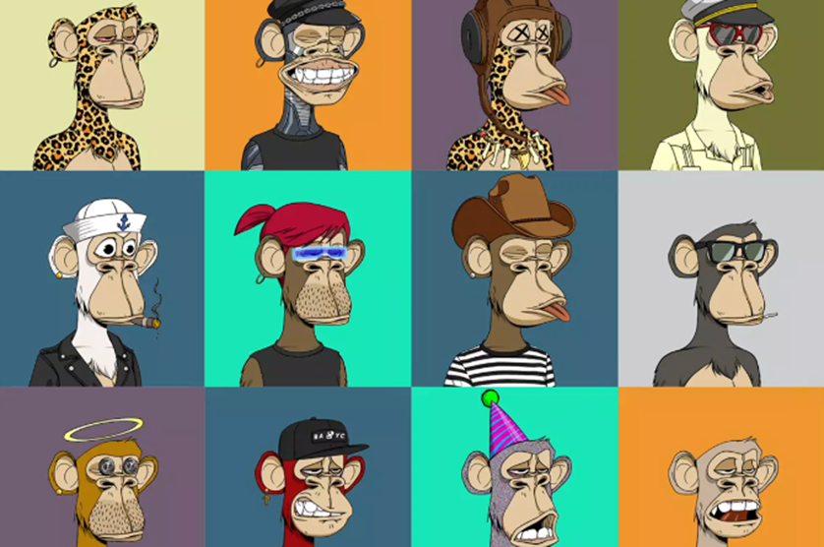

Slide 57
NFTs
NFT contracts are simply decentralized apps that implement ownership over digital assets (e.g. digital art presented by media files).
Typically, NFT contracts inherit from the standard ERC721 contract.
The basic functionality is implemented by the ERC721 base class:
Minting: creating a new token with a given id and owner address.
Transfer ownership from one address to another.
Ownership queries: who owns token with id 24?
Balance queries: how many tokens does Alice have?

Slide 58
Our Plan: Verifiably Random NFTs
The NFT Contract
VRF Contract
1. Deploy
The contract is deployed to Ethereum. Possibly with some metadata attached.
3. Revealing the Art
Once randomness is received
2. Minting
Once the contract is up, we can create new tokens using a mint function.
Upon mint, the contract requests randomness from a VRF oracle.

Slide 59
Hands-On

Slide 60

Writing Smart Contracts
Solidity is a programming language for writing contracts.
Remix is a web IDE for writing, testing and deploying smart contracts.

Slide 61


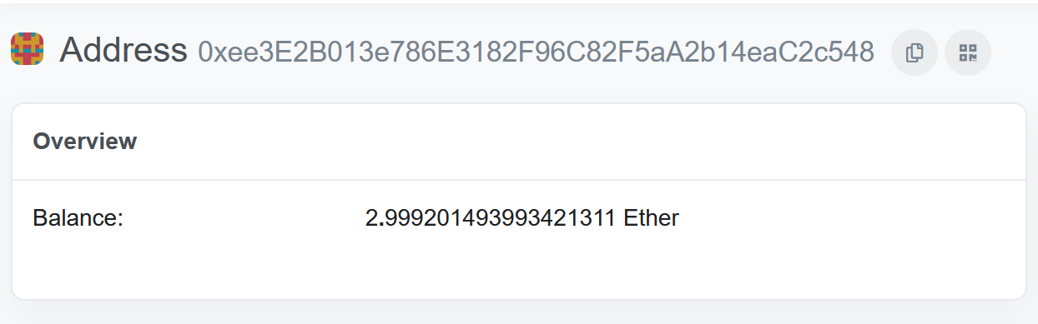
Accounts
The Ethereum network allows accounts of two types:
Users
Smart Contracts
Any account has an address and a balance.

Slide 62
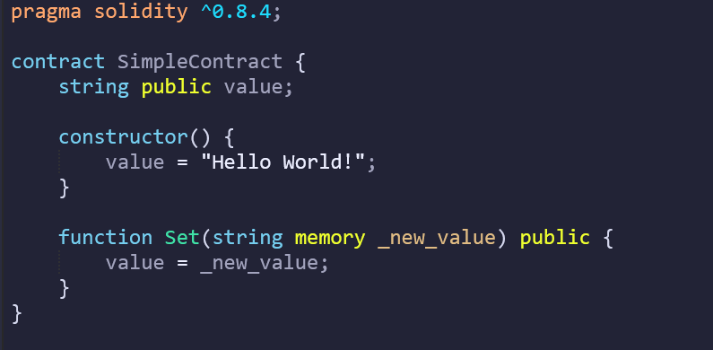
Contracts
Any smart contract on Ethereum is an instance of a contract class.
member fields
(the state)
a constructor
(optional)
member functions
(the rules)

Slide 63
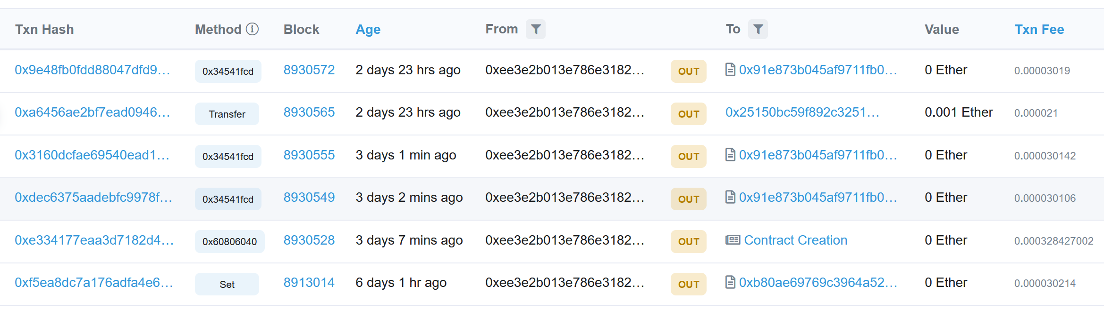
Transactions on Ethereum
Types of transactions:
A transfer of Ether from one account to another.
A deployment of a new contract deployment.
A function call to an existing contract.

Slide 64
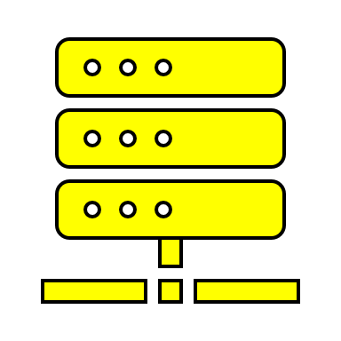



Gas
Function calls cost gas.
The cost is determined by the consumption of computation time and memory.
Contract.Func()
time + memory
gas
The price per gas is determined by the sender of the call.
price per gas
gas
txn fee

Slide 65
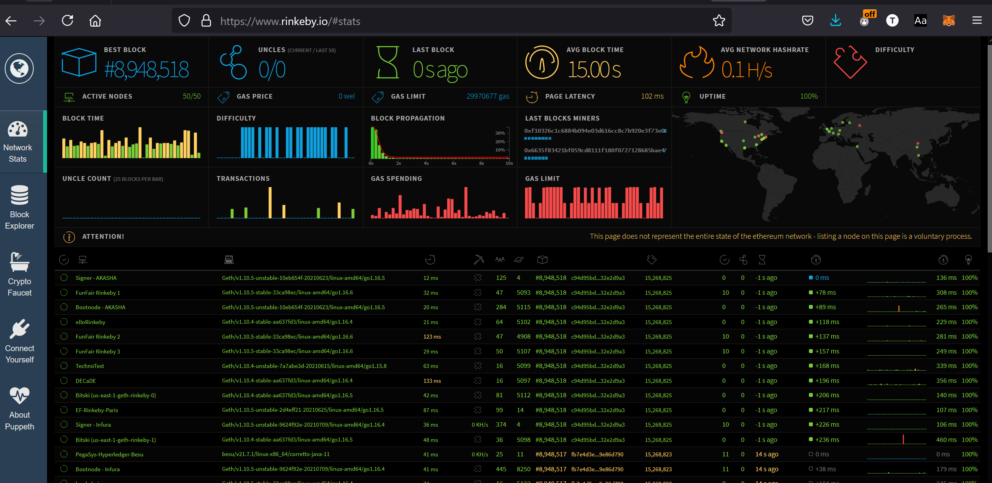
The Rinkeby Testnet

Slide 66
Resources for tutorial:
bit.ly/3rcIOtx

Slide 67

Insert your address here:
bit.ly/3ejyASA

Slide 68
Open Remix
https://remix.ethereum.org

